Slide 2
Presentation Title
Le Tuan Hung l Agentic AI the next through of Generative AI

Slide 3
Agentic AI – The Next Breakthrough After GenAI
1. Why is there an explosion of AI ?
2. Why is GenAI not enough ?
3. The upgrade from GenAI to Agentic AI
4. Applications & Future of Agentic AI
5. Q&A

Slide 4
Why is there an explosion of AI

Slide 5
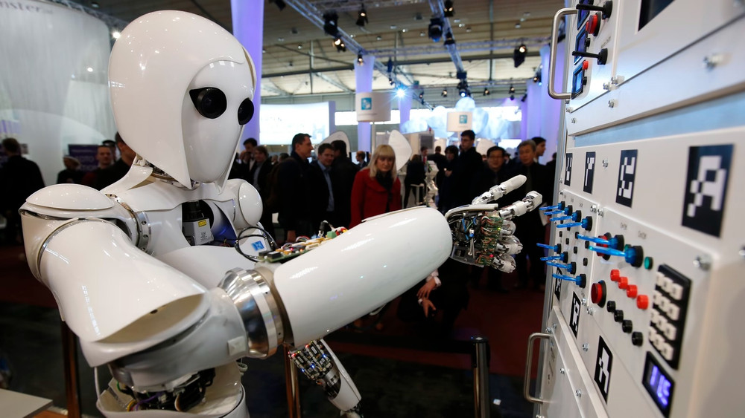
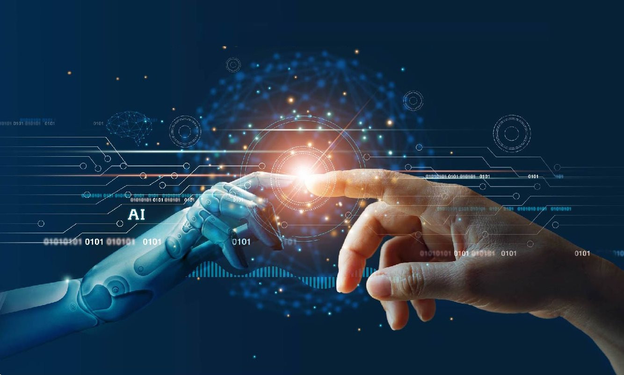
Why is there an explosion of AI
Before 2017
Can’t read big data from human
Read sequentially => Very low
Human language is very ironic
Example
I can’t fit the laptop into the bag because it’s too big
I can’t fit the laptop into the bag because it’s too small

Slide 6
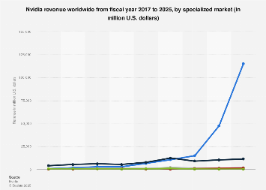
Why is there an explosion of AI
Transformer
Read the entire context
Find the relation between words
Undergoes multiple layers of analysis
Solve problems
Solving the data access problem
Need GPU process
=> NVIDIA explodes
All companies join, and that is the main reason explosion of AI

Slide 7
Why is GenAI not enough

Slide 8
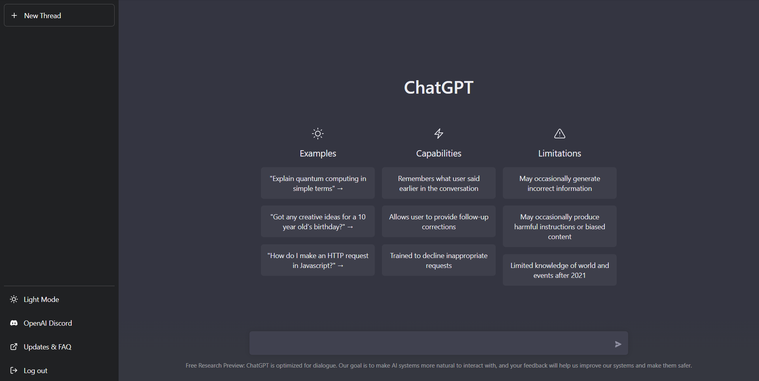
The development of GenAI
Generative AI
Predict words
Based on probability and from human context.
In 2022
Chat GPT was created
Chat interface, like a human
100 million users
Change the way learn and work

Slide 9
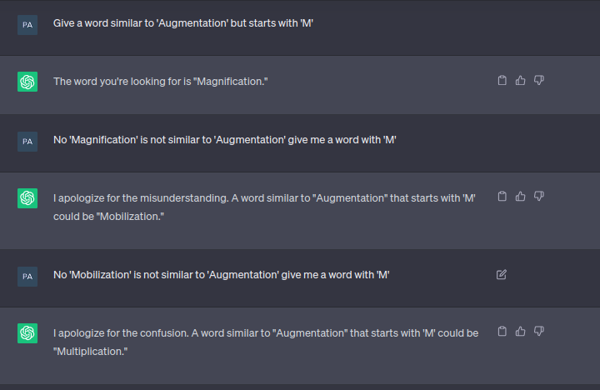
The problems of GenAI
Hallucination
Context window
Knowing, not doing

Slide 10
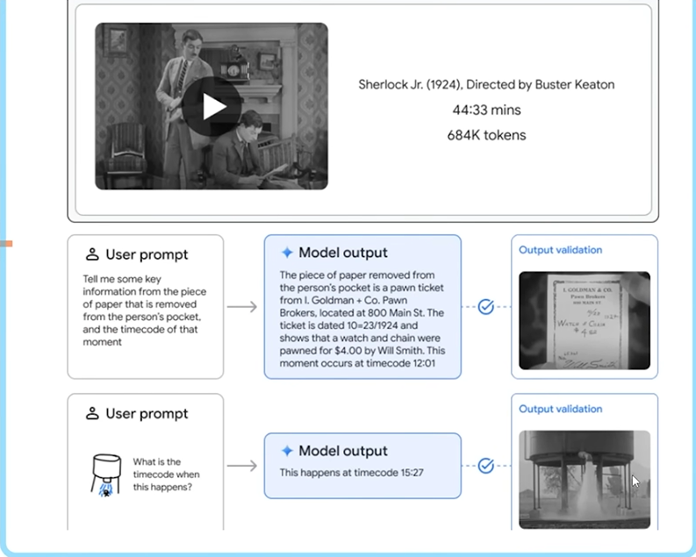
How to solve this problems
Many companies find solution
Google released Gemini 1.5
GenAI offers many things, but, it still needs human intervention
Agentic AI released

Slide 11
The upgrade from GenAI to Agentic AI

Slide 12
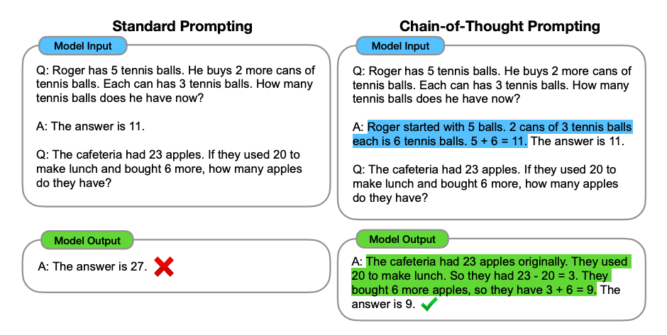
Agentic AI
Idea
Why LLM answer immediately ?
If we allow it “draft” before execute, what happen ?
Execution
Chain of Thought term
If we allow it “draft” before execute, what happen ?

Slide 13
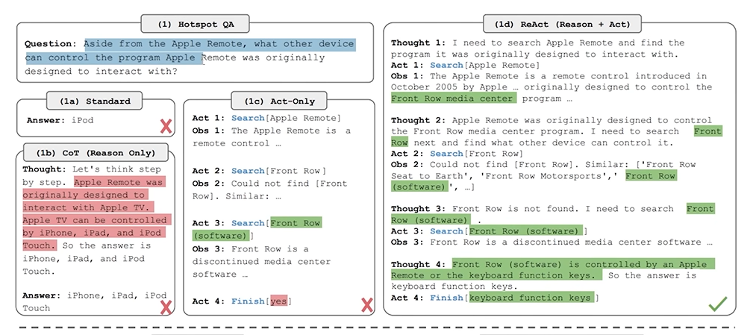
Agentic AI
Chain of thought (React – Reason + Act)

Slide 14
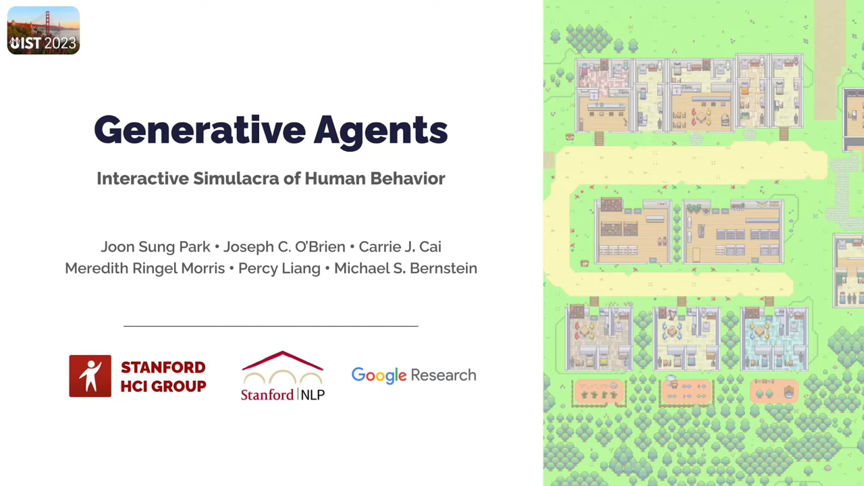
Smallville
With 25 AI agents interact, no script, each character is a unique individual

Slide 15
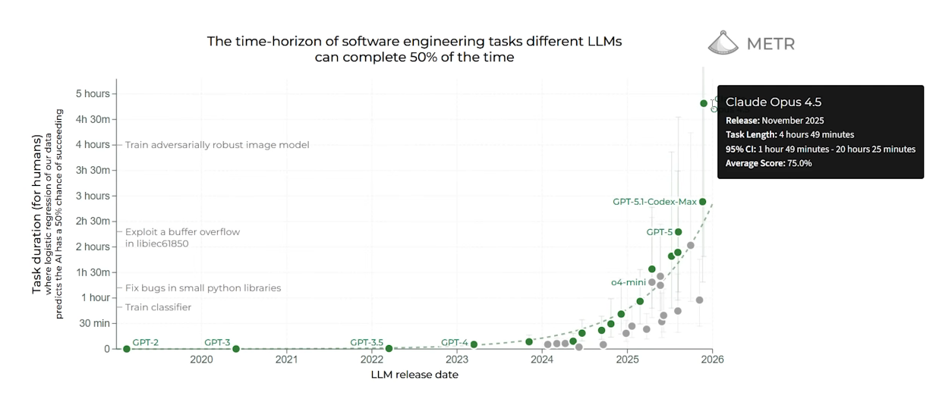
Why now ?

Slide 16
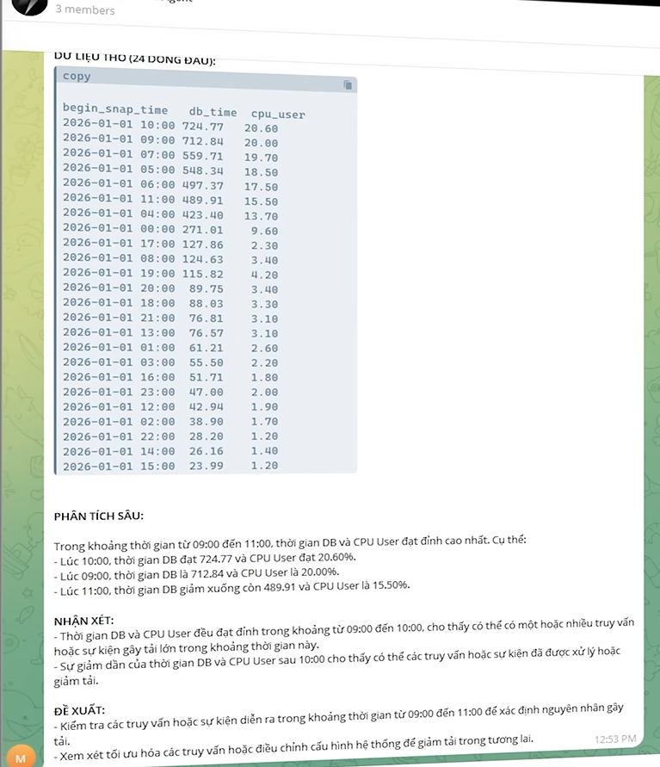
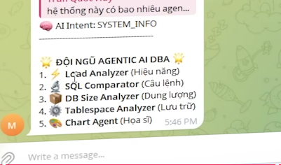
Agentic AI
Ques: How many agents are there in this system and what are their roles ?

Slide 17
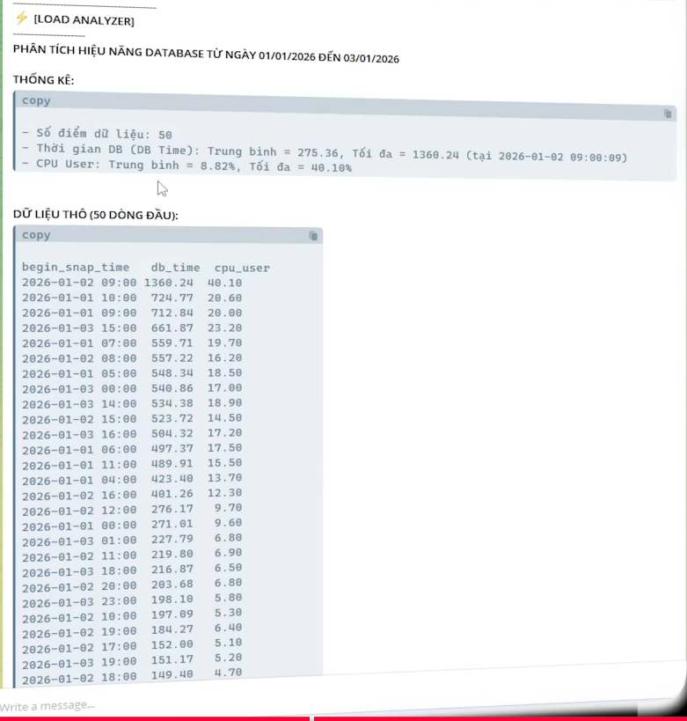
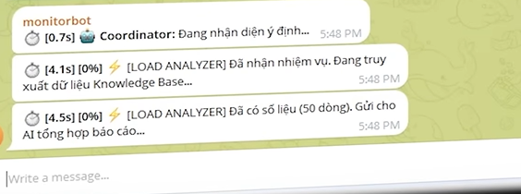
Agentic AI
Ques: If I want to check database from 1/1/2026 to 3/1/2026

Slide 18
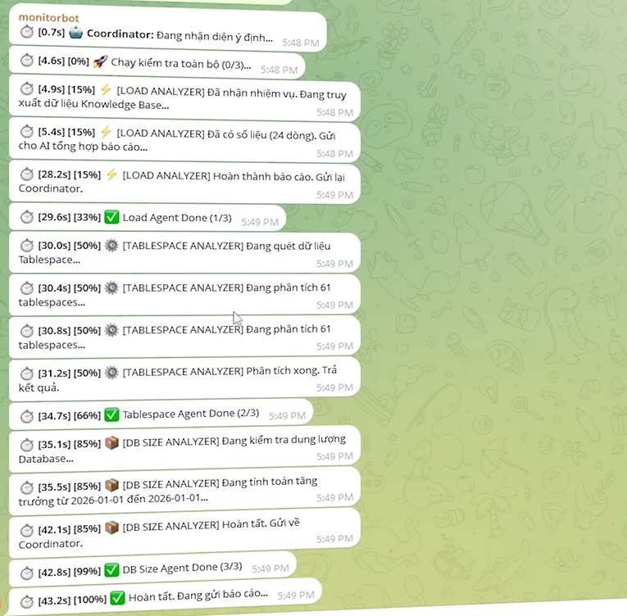
Agentic AI
Ques: If I want to check entire system

Slide 19
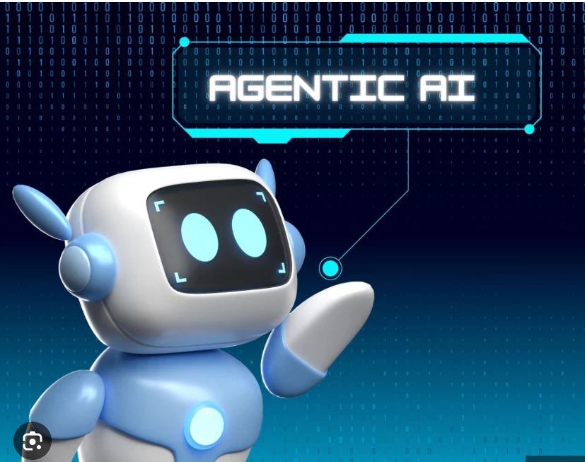
Agentic AI
Agentic AI
Goad-driven – understands and works toward objectives
Autonomous – acts without step-by-step instructions
Planning – creates and executes multi-step workflows
Adaptive – monitors progress and adjusts actions

Slide 20
Applications & Future of Agentic AI

Slide 21
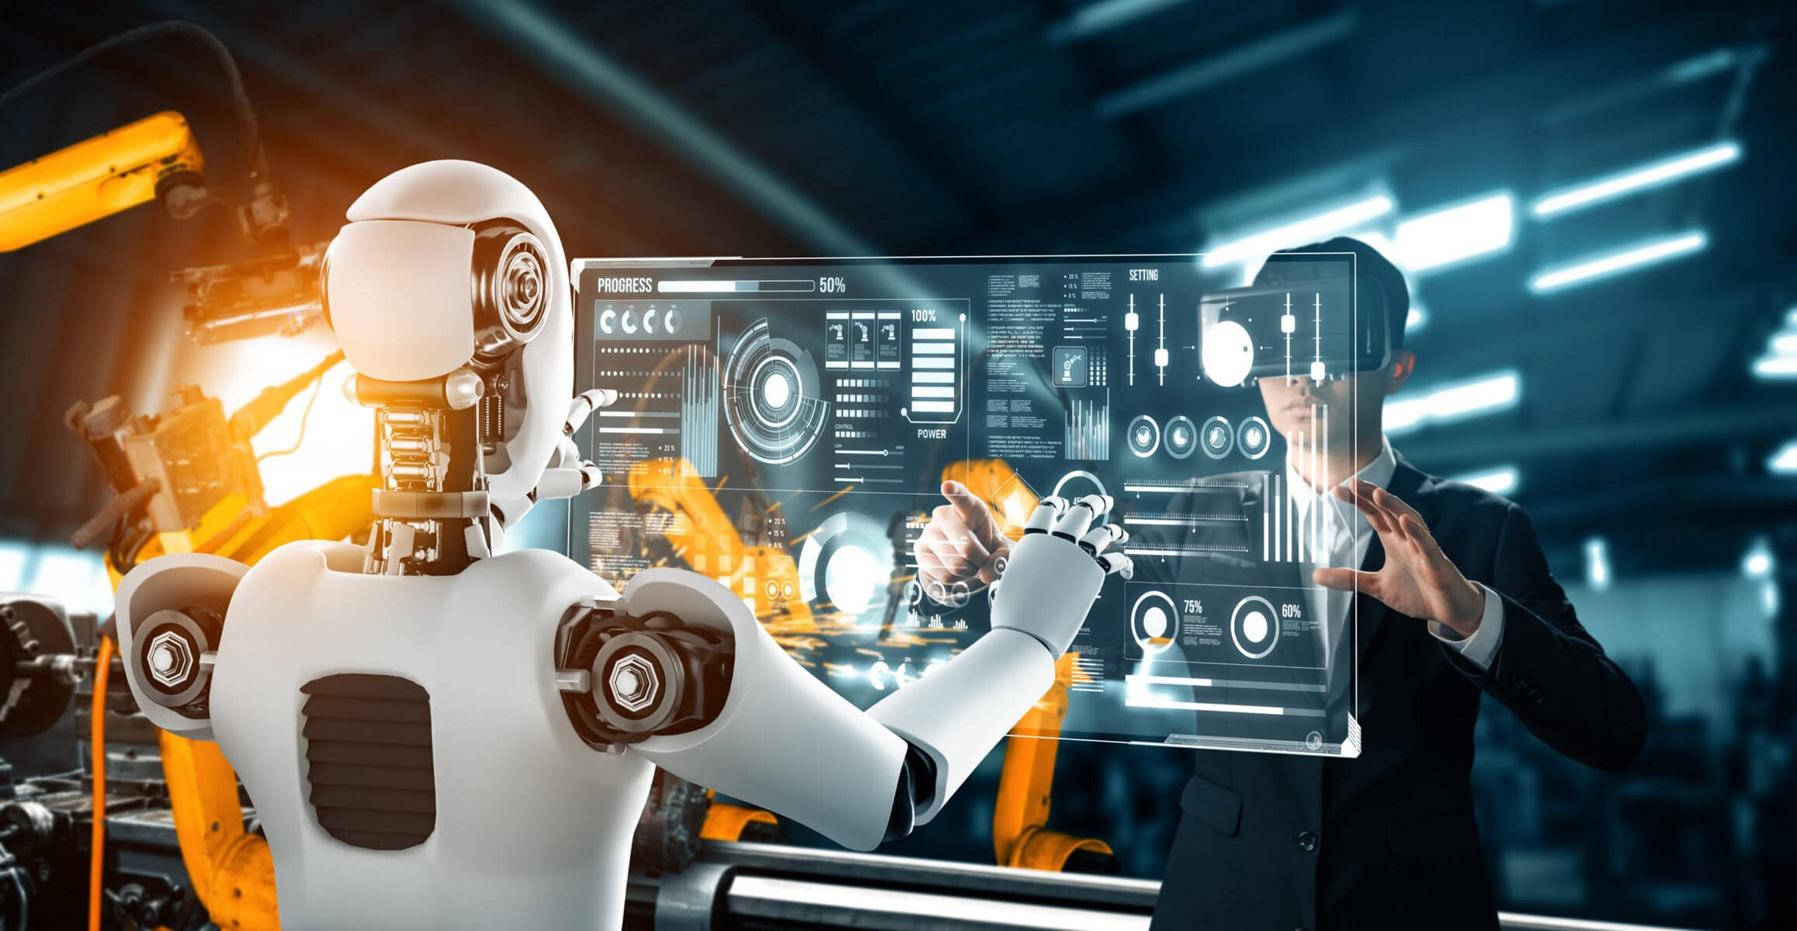
Agentic AI Applications
Manufacture
Automated monitoring
Anomaly detection
Optimizing automated processes
Predictive analytics

Slide 22
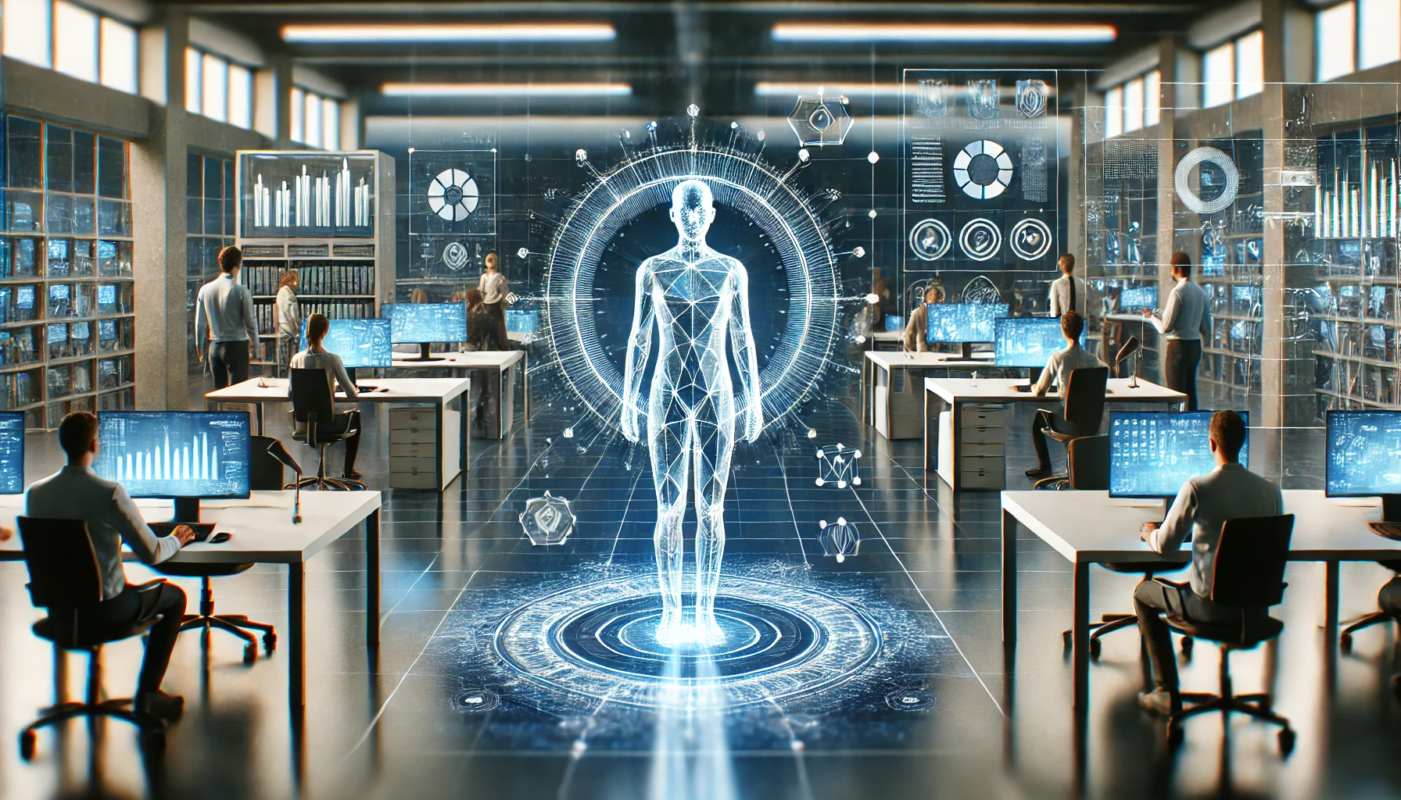
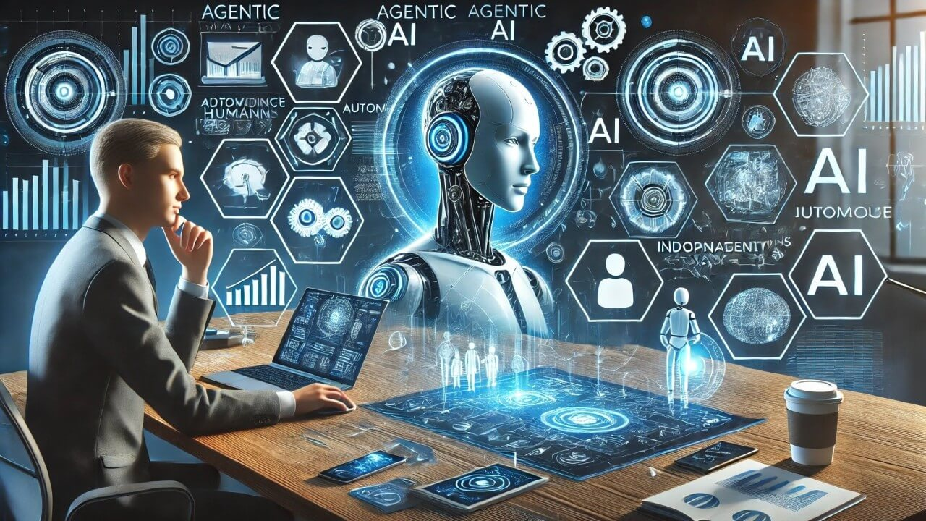
Agentic AI Future
Creating outstanding competitive advantage
A chance to move in sync with the world
Massive AI power = New opportunities for early adopters

Slide 23

Q&A

